Slide 1

Breast cancer survival prediction

Slide 2

Data loading & initial setup
Libraries Used: pandas, numpy, matplotlib, seaborn, scipy.stats, sklearn libraries for preprocessing, modeling, evaluation.
Dataset Loaded: Breast Cancer METABRIC.csv
Tools: Python, Jupyter Notebook
This Photo by Unknown Author is licensed under CC BY-NC

Slide 3

Data understanding
Columns Included:
Patient demographics
Clinical features (Tumor size, Stage, Grade)
Treatment (Chemo, Hormone, Radiation)
Genetic/molecular markers (ER, PR, HER2)
Target Column: "Patient's Vital Status" (Alive/Dead)

Slide 4

Data cleaning & preprocessing
Removed duplicate rows.
Handled missing values using .dropna().
Used LabelEncoder and custom mappings (e.g., High = 2, Moderate = 1, Low = 0).
Removed unnecessary or low-value columns like 'Cancer Type Detailed', '3-Gene classifier subtype', etc.
Removed rows where "Patient's Vital Status" was 'Died of Other Cause'.

Slide 5
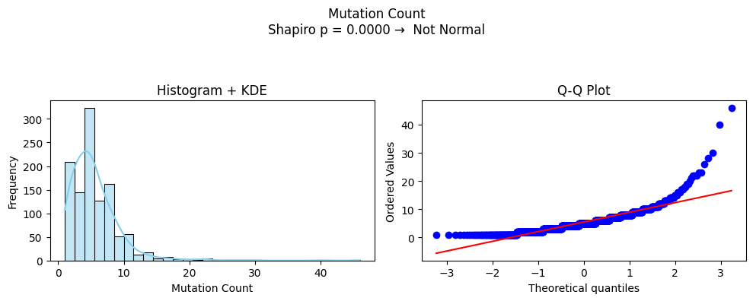
Exploratory data analysis
Plotted histograms + Q-Q plots for checking normality.
Applied IQR method to remove outliers.
Used .value_counts() on "Patient's Vital Status" to understand class imbalance.

Slide 6
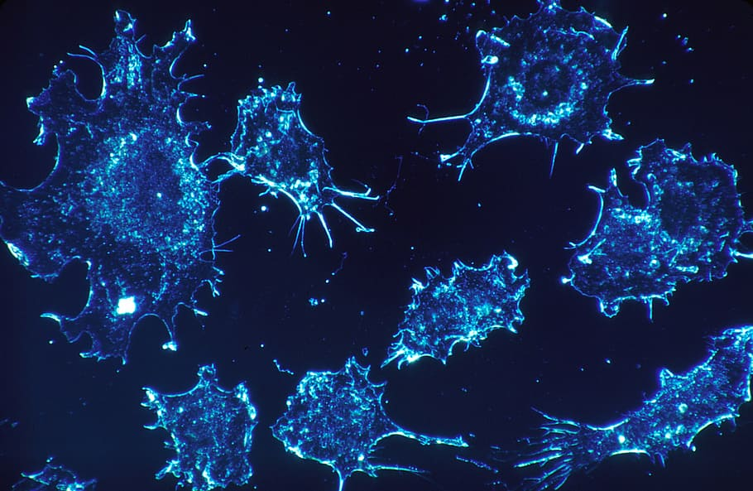
Feature Selection
Selected important features like:
Age at Diagnosis, Tumor Stage, Tumor Size, Lymph nodes examined positive, Mutation Count
ER Status, PR Status, HER2 Status
Neoplasm Histologic Grade, Nottingham prognostic index
Used correlation plots to verify relevance.

Slide 7
Train-Valid-Test Split
Used train_test_split with stratification:
70% Training
30% Validation
20% Test from the training set
Used MinMaxScaler for scaling.

Slide 8
Tried 9 models:
Logistic Regression
Support Vector Machine
Random Forest
Decision Tree
K-Nearest Neighbors
Gradient Boosting
AdaBoost
Naive Bayes
XGBoost
Evaluation Metrics:
Accuracy
Precision
Recall
F1 Score
Model Building & evaluation

Slide 9
Hyperparameter tuning
Used GridSearchCV and RandomizedSearchCV to find best parameters for:
RandomForest

Slide 10
Overfitting/Underfitting analysis
Observed overfitting when training accuracy = 1.0 and validation accuracy was low.
Used cross_val_score to check model generalization.
Train Accuracy: 0.828080229226361
Validation Accuracy: 0.7835671342685371
Test Accuracy: 0.7895791583166333

Slide 11

Final model deployment
Saved the model using joblib.
Created a Streamlit application:
Name: Breast Cancer Survival Prediction Model
Input: 11 features from the imp_data subset.
Output: Predicts whether a patient will be Alive or Dead.

Slide 12

THANK YOU !

